Slide 1
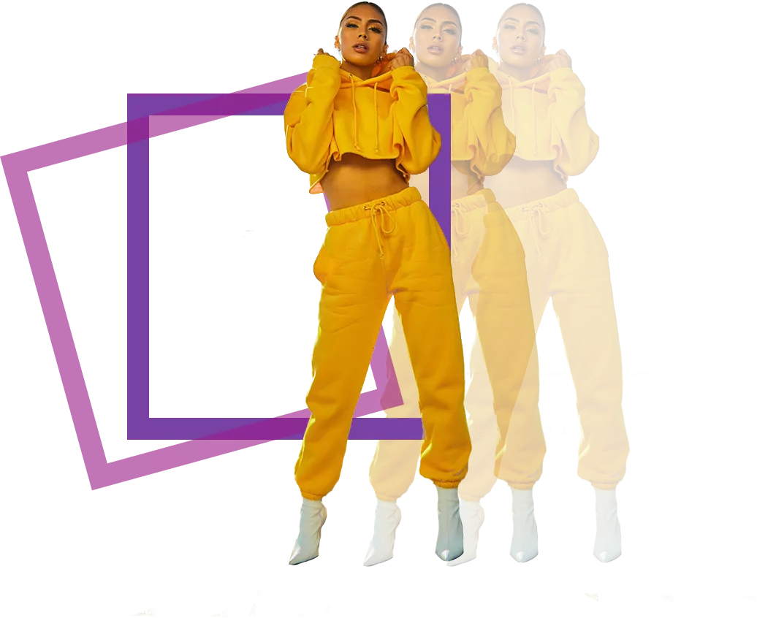
Fashion
Recommendation
System For
Images
D. Phani Harsha
Thanusha Illa
Surya Hemanth
Abhinava Reddy
Sai Kumar
Kanaka Raju

Slide 2
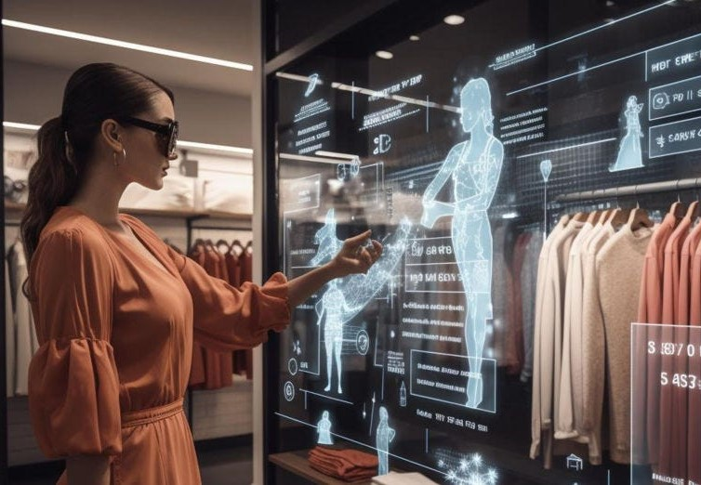
INTRODUCTION
Fashion recommendation systems are intelligent platforms designed to suggest clothing and accessories to users based on their preferences.
The main of this project developing an intelligent system that suggests fashion items based on user preferences and image analysis. The system utilizes machine learning and computer vision techniques to analyze clothing items in images and recommend similar or complementary items to the user.
By integrating data on trends, styles, fashion recommendation systems aim to enhance user experience, increase engagement, and drive sales for retailers.

Slide 3
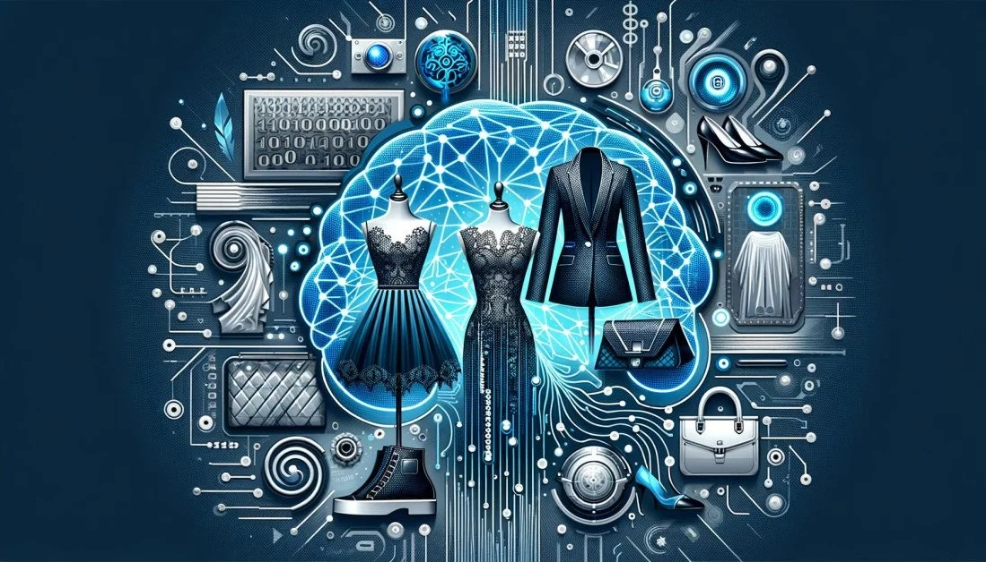
Integration of various recommendations
Text search Recommendation
AI Image Recommendation
Live Camera Recommendation

Slide 4
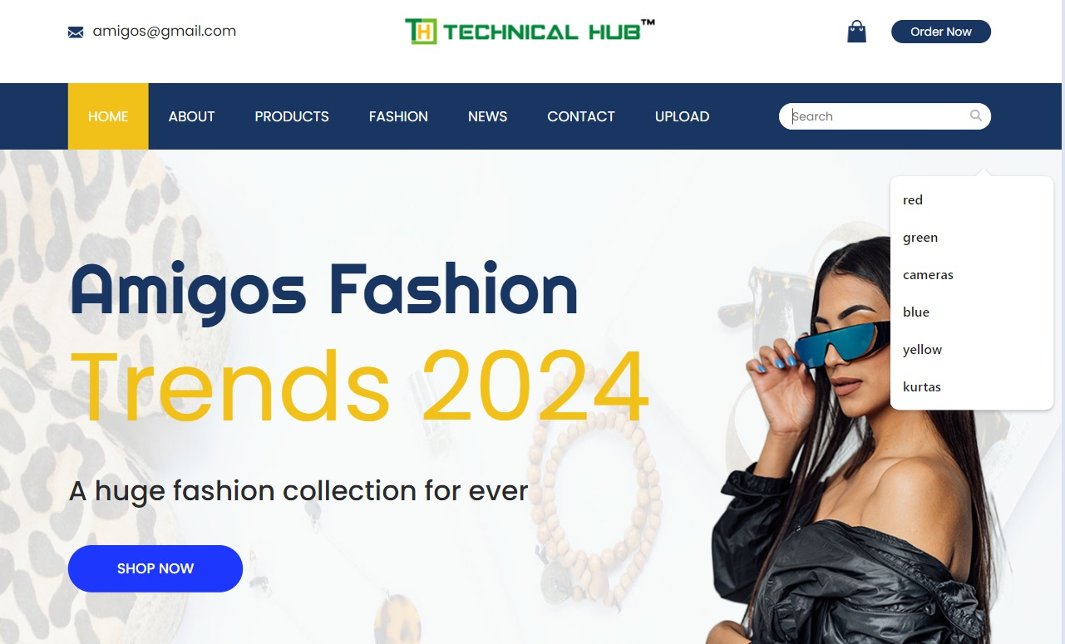
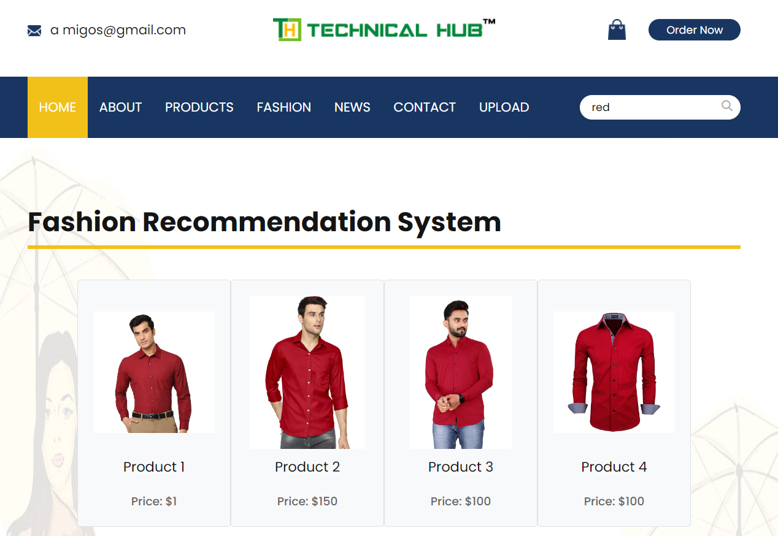
Our Website interface
Text Search Recommandation

Slide 5
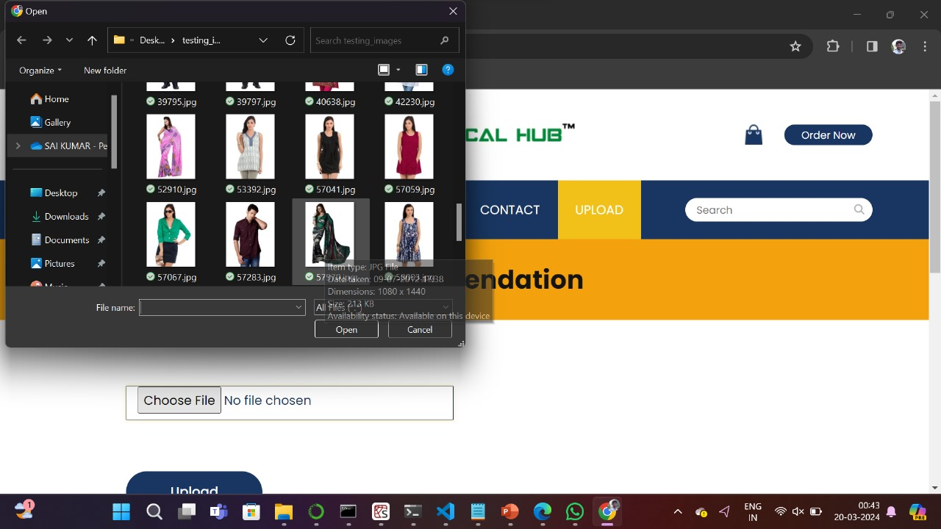
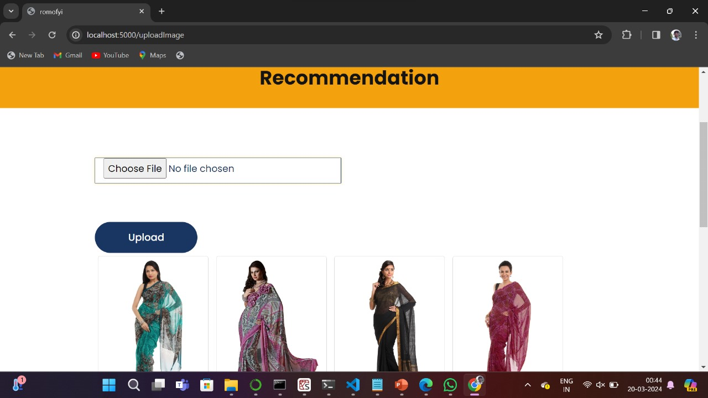
AI Image Recommandation
Recommanded products based on the Style and pattterns

Slide 6
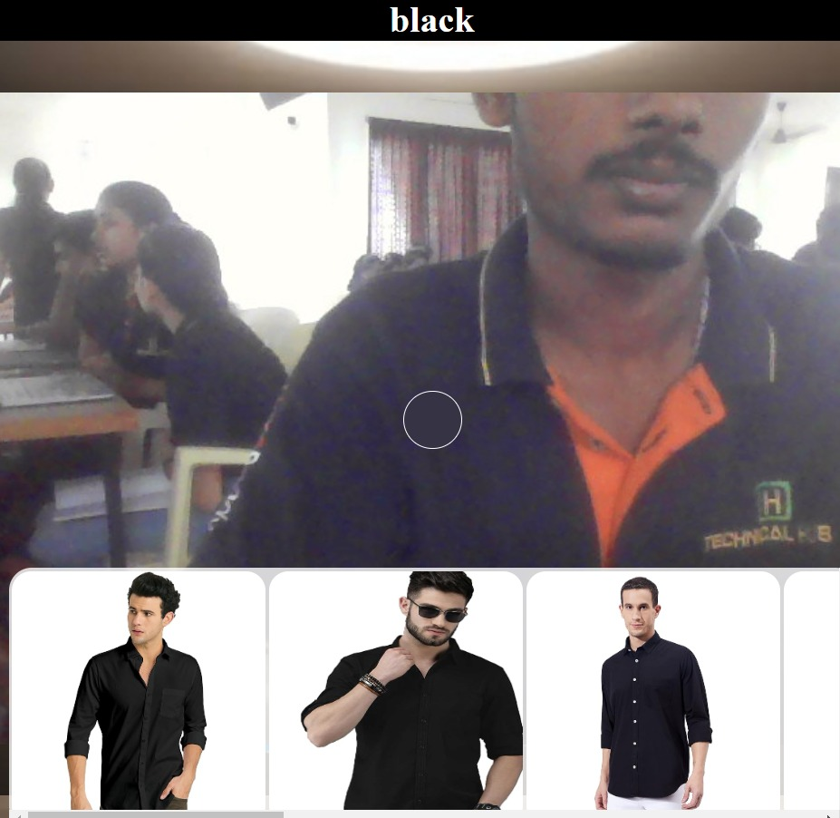
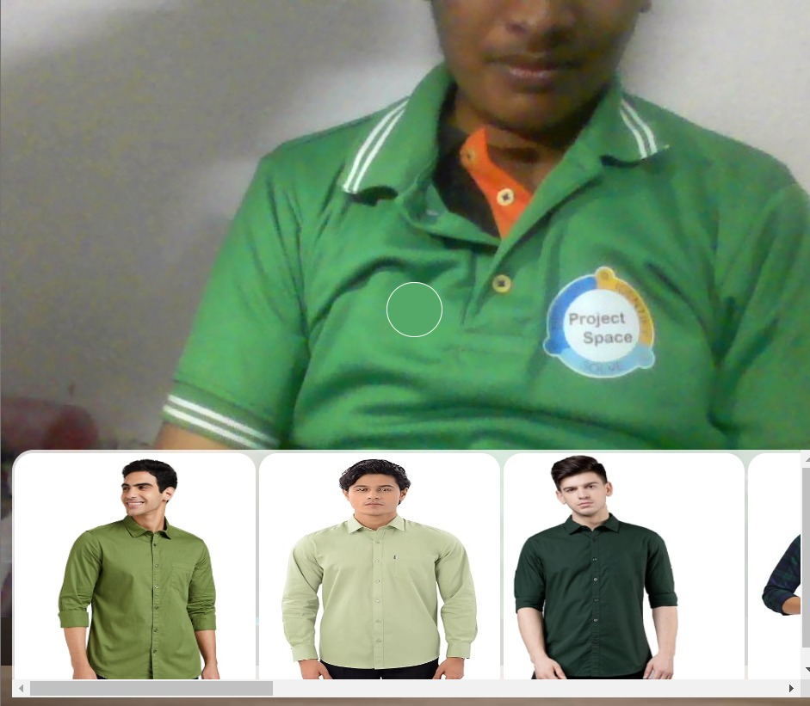
Live Video Recommandation
Based on the colour Products will be recommanded

Slide 7
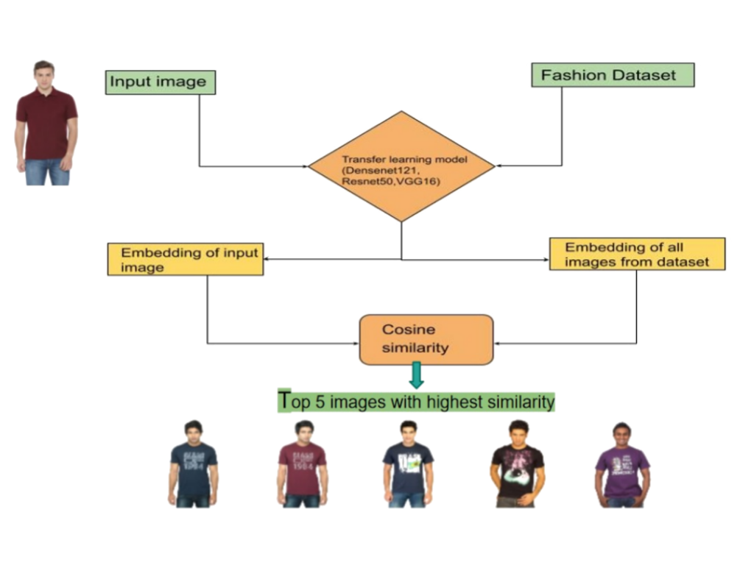
Input Image: This is the starting point of the process. Any product-based image is provided as input to the system.
Deep Learning Model: The preprocessed image is fed into a deep learning model that has been trained on product images. This model could be a convolutional neural network (CNN) or any other architecture suitable for image recognition tasks.
Feature Extraction: The model extracts features from the input image. These features represent various characteristics of the product such as color, texture, shape, etc.
Similarity Calculation: The extracted features are compared with a database of product features. This comparison is usually done using similarity metrics such as cosine similarity or Euclidean distance.
Matching Products: Based on the similarity scores, the system identifies products from the database that closely resemble the input image.
Output: The matched products are presented as output, either in the form of a list or visually represented to the user.
Our Backend Process

Slide 8
Advantages
Time-saving: Personalized recommendations reduce browsing time, allowing users to swiftly discover items matching their style, thus streamlining decision-making.
Enhanced Shopping Experience: Tailored selections cater to users' tastes, making shopping not just efficient but also enjoyable and satisfying.
Discover New Styles: Recommendations expose users to fresh trends and brands, broadening their fashion repertoire and inspiring creativity in wardrobe choices.
Simplified Shopping: Personalized suggestions eliminate the hassle of shifting through options, enabling users to quickly find items that suit preferences and budget, enhancing overall convenience

Slide 9

Conclusion
The future of fashion recommendation systems looks really promising. These systems are getting better at suggesting clothes and accessories that suit your style and preferences. We use AI to do this. So, get ready for a whole new way of shopping.
We're currently in the planning phase for our website launch! We're brainstorming ideas and laying out our vision to create an engaging and user-friendly online platform. Our goal is to offer a seamless shopping experience that caters to your needs and preferences. Stay tuned for more updates as we work diligently to bring our website to life!

Slide 10

Special Thanks to our mentor
Rajesh Bolla Sir

